Slide 1
The company presentation provides a comprehensive overview of our organization and the value we offer to our customers, job applicants, and interested parties
Foreword to the presentation
The presentation is versatile and can be utilized in its entirety or as separate modules, depending on the context. Adapting the storyline to the audience's existing knowledge can greatly enhance the effectiveness of the presentation.
When making an initial contact or presenting at a trade fair, discussing the msg group in a general and broad manner can prove beneficial. Alternatively, you may opt to utilize a limited number of slides for a brief introduction in order to promptly delve into the main content of the presentation.
The company presentation contains numerous pre-drafted statements and commitments. In addition to their applicability in this presentation, they can also be directly used in discussions.
Please
delete
this slide
later

Slide 2

Accelerating Transformation
Consulting, software and services
to enhance your competitive edge
msg Company Presentation 2025

Slide 3

Let’s talk digital!
Thinking business transformation sustainably
msg Company Presentation 2025

Slide 4



1
The msg group at a glance
2
Intelligent solutions and IT consulting
3
Convincing success stories
4
Our strengths, your benefits
5
Digitalization as the central key to sustainability and ESG

Slide 5

1
Industry know-how and IT expertise from a single source
The msg group at a glance

Slide 6


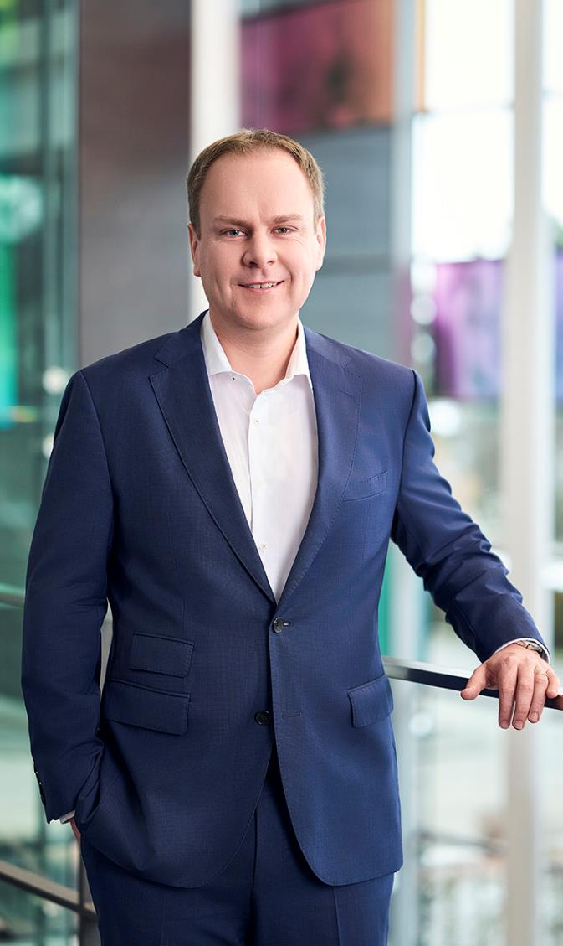
Putting people first: as customers, as users of our solutions and as employees.
We build on 40 years of industry expertise and the creative and solution-driven entrepreneurial spirit that has always been our hallmark. As one of the few owner-managed IT consulting companies in Germany, we draw on the diversity within our group of companies, from the initial idea through to application.
We acknowledge this consideration with our motto “value – inspired by people”.
Dr. Jürgen Zehetmaier
CEO msg

Slide 7

Why msg is the right partner
The msg group at a glance
As an owner-managed company, our actions are directed
towards people: Business partners and employees are our focus.
Because we are convinced:
This is the only way to find the best solutions.

Slide 8

Why msg is the right partner
The msg group at a glance
msg demonstrates entrepreneurial spirit and courage.
We are continuously exploring new opportunities with our business partners to pave the way for the future.

Slide 9

Why msg is the right partner
The msg group at a glance
Our business partners can rest assured that msg “delivers”.
The msg brand is dedicated to fostering entrepreneurship and
is driven by long-term sustainability rather than quarterly figures.

Slide 10




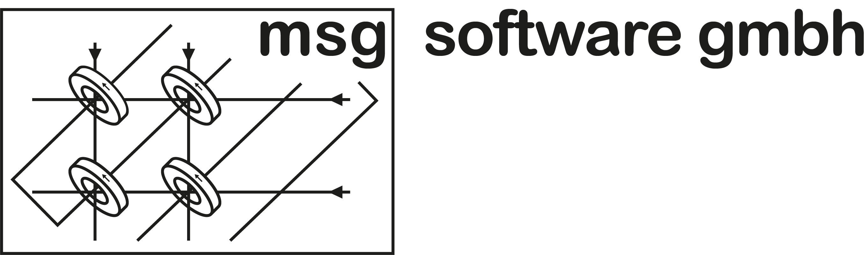


From a start-up with three founders to a billion-dollar company boasting a global workforce of over 10,000 IT and industry experts
The msg group at a glance
Three former IT interns
found msg, ...
... one of the largest consulting
and IT companies in Europe
10,500 experts
3,000 customers
34 countries
3 founders
1 customer
1 country
1980
1990
1995
2001
2014
2025

Slide 11




































The comprehensive strategy employed by the msg group has been instrumental to its success for more than four decades
The msg group at a glance
1980
2000
2025

Slide 12



We are an internationally operating group of companies with in-depth industry expertise
The msg group at a glance
41.2 %
17.9 %
1.46 bn euro
sales in 2024 (preliminary)
Banking
New
since
2025
Insurance
15.8 %
8.4 %
Defense &
Aerospace
34
countries
> 10,000
employees
Horizontals/
Other
Industry
Segment
5.1 %
10.7 %
Automotive &
Manufacturing
1.0 %
Public Sector
Healthcare

Slide 13
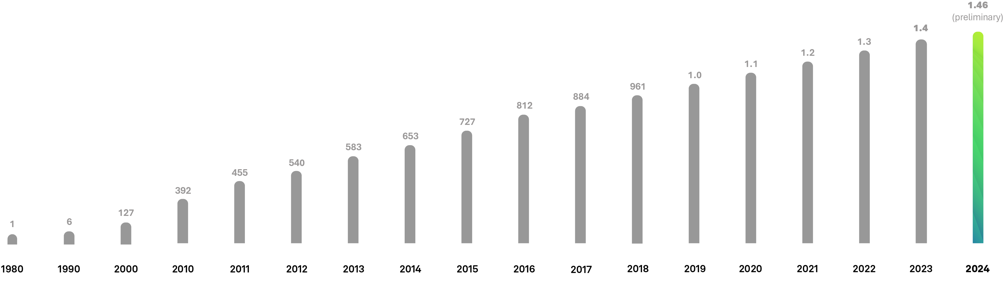
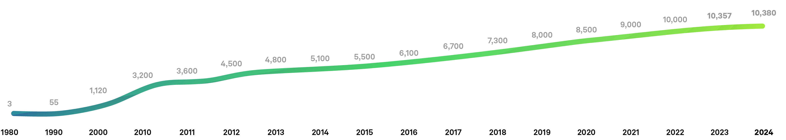
From start-up to the largest independent owner-managed consulting and IT company in Europe with innovative business models
The msg group at a glance
Sales
Growth
in € million
Headcount Growth

Slide 14
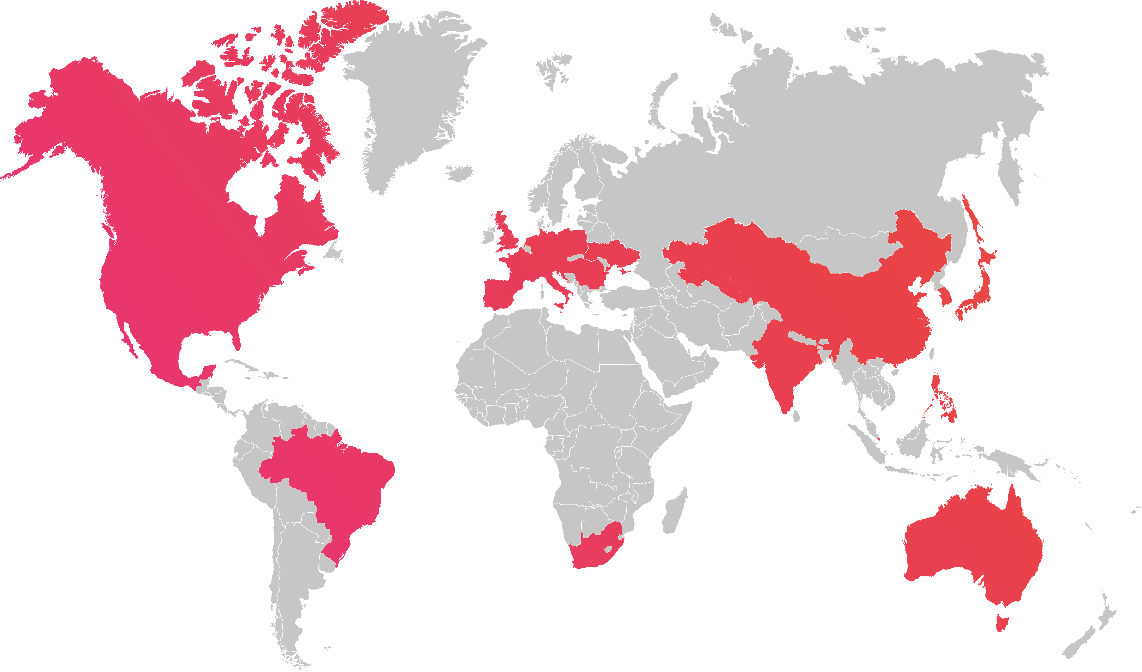
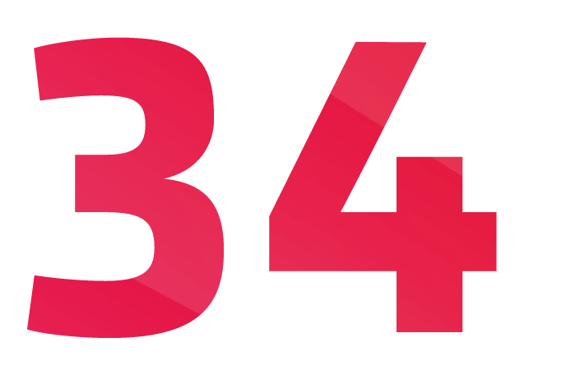
Our customers benefit from our global presence
The msg group at a glance
Countries
Germany | Bulgaria |
France | Italy | Croatia |
Malta | Netherlands | Austria | Poland | Portugal | Romania | Switzerland | Serbia | Slovakia |
Slovenia | Spain |
Czech Republic | Hungary |
United Kingdom | Ukraine |
Australia | Brazil | China |
India | Japan | Canada |
Kazakhstan | Korea | Mexico |
Philippines | Singapore |
South Africa | Uzbekistan | USA

Slide 15
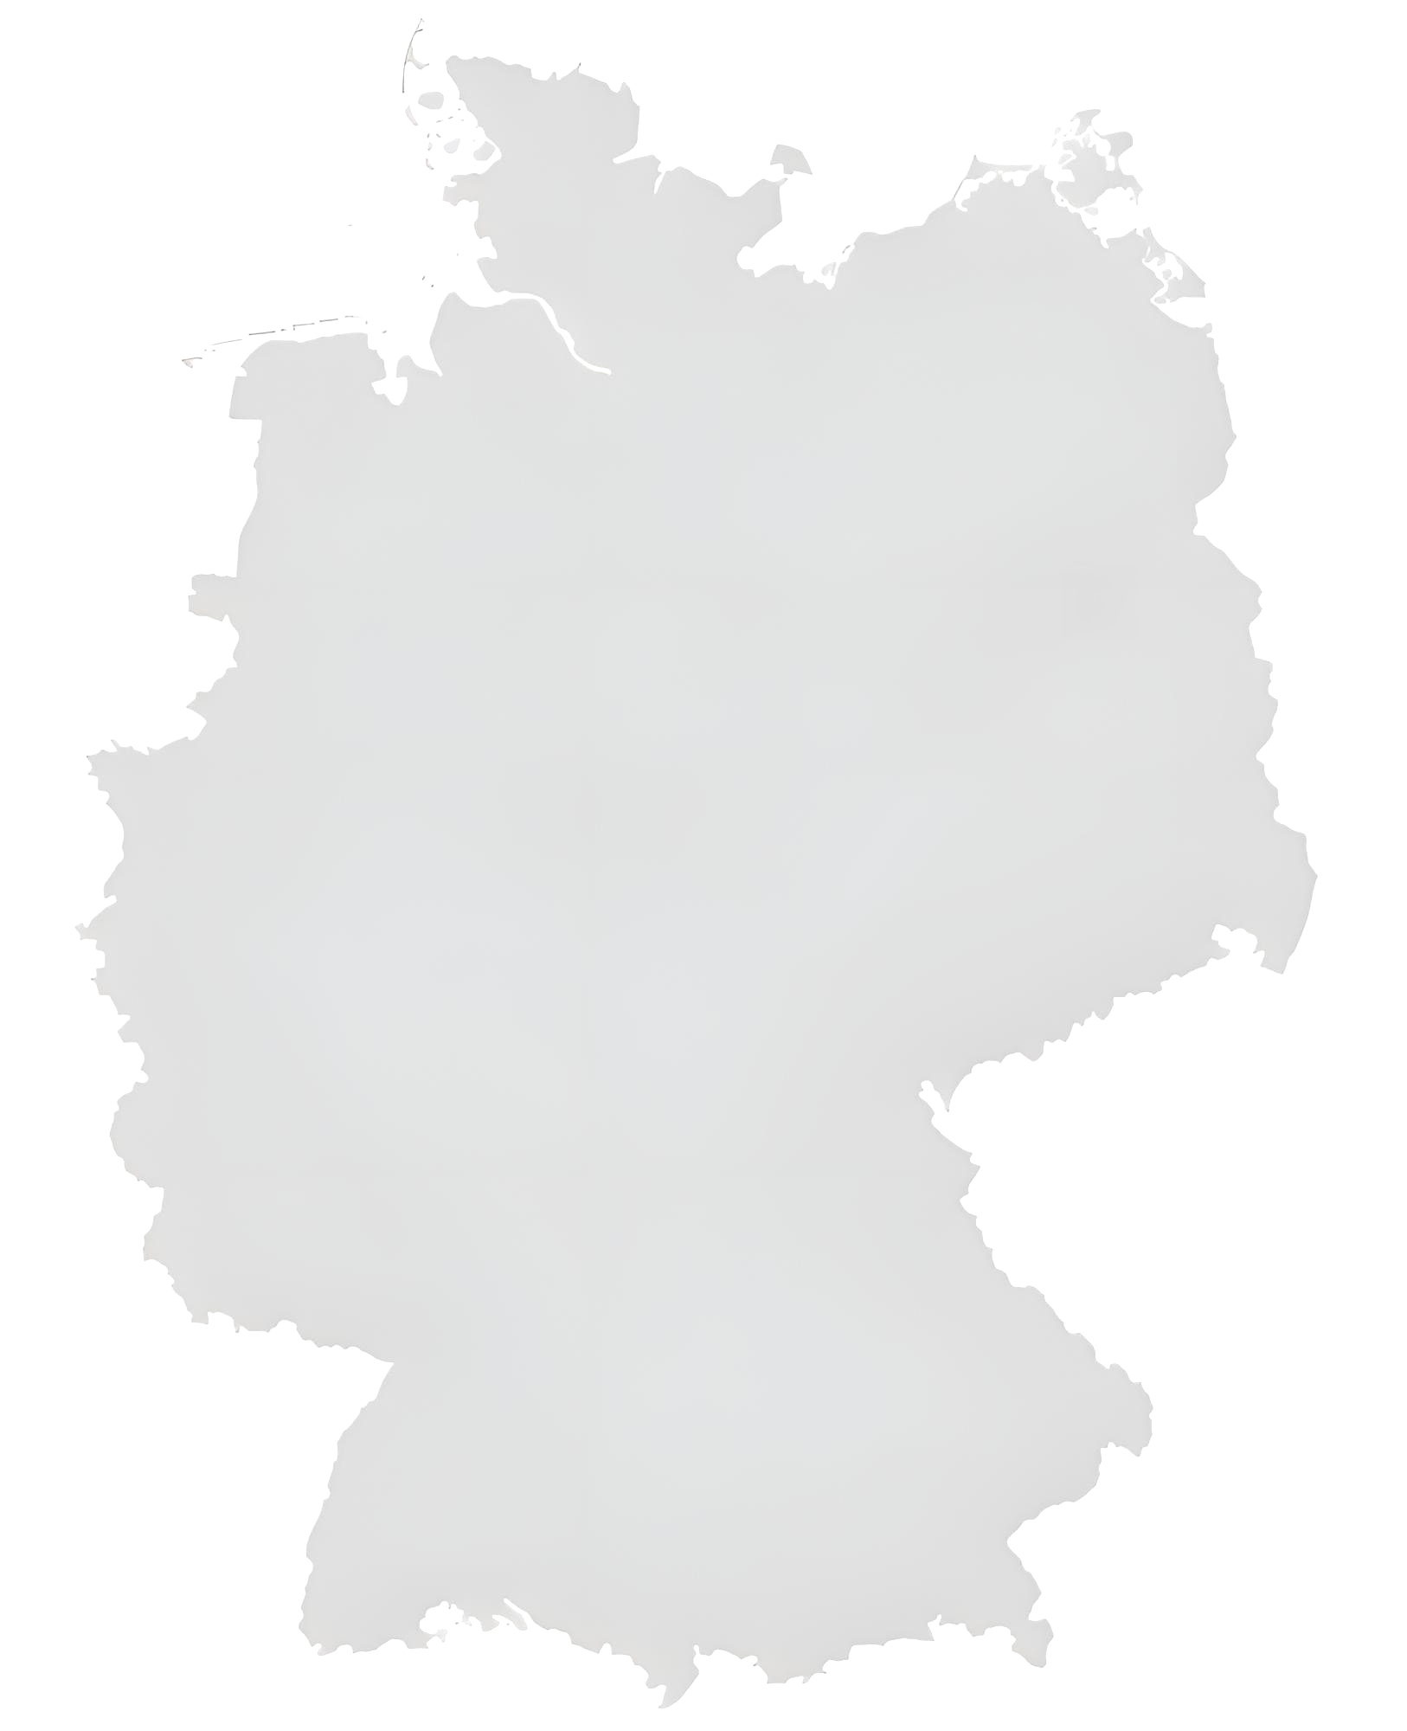
Local presence for our German customers is what really characterizes us
The msg group at a glance
Schortens/Wilhelmshaven
Hamburg
6,800
Hannover
Employees
Lingen(Ems)
Berlin
Dissen
Braunschweig/Wolfsburg
Münster
Essen
22
Düsseldorf
Görlitz
Cologne
Chemnitz
Locations
Frankfurt/M.
Würzburg
969
Walldorf/Heidelberg
Nuremberg
Karlsruhe
million € sales in 2024
Stuttgart
Passau
St. Georgen
Ismaning/Munich

Slide 16



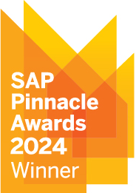







msg consistently receives awards in external market comparisons and partner competitions
The msg group at a glance
Digital Core
Partner Application Industry Cloud
AI Partner Innovation
Platforms & Technology
(Cloud)
Platforms & Technology
(On Premise)
Partner Application Industry Cloud
As the only company in the top 25 since
the start of the survey.
2024
Place
4

Slide 17
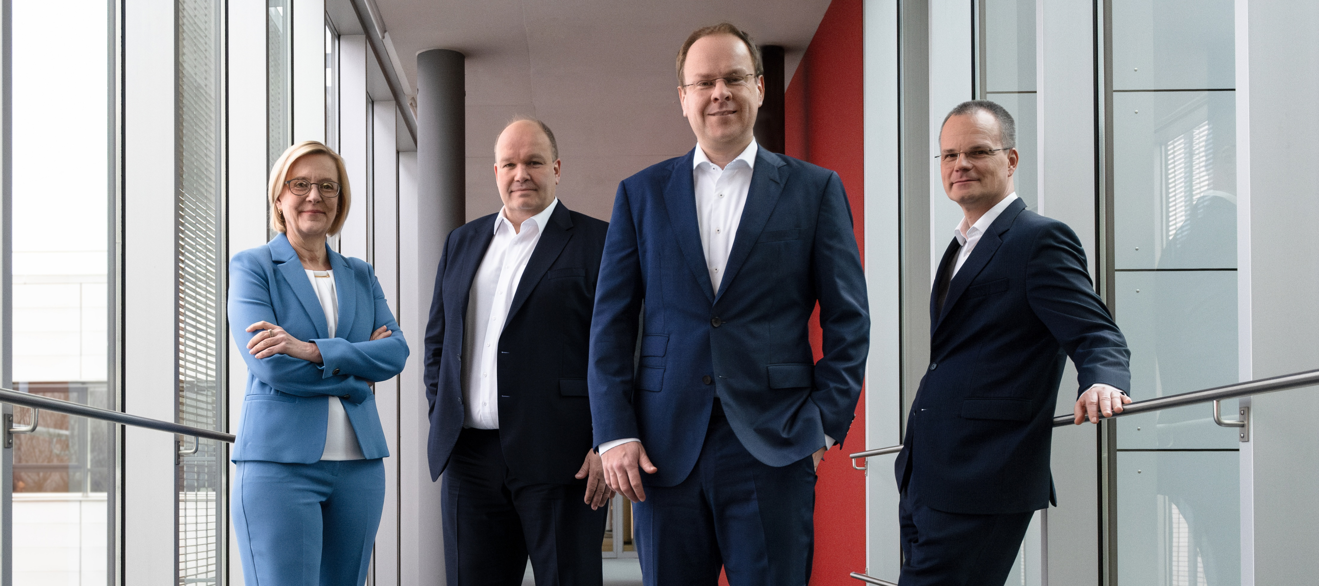
Our understanding of our customers' business characterizes us at all levels - including on the Group's Management Board
The msg group at a glance
Dr. Andrea
van Aubel
Karsten
Redenius
Dr. Jürgen
Zehetmaier
Dr. Frank
Schlottmann
Chairman of the Management Board
Insurance
Operations
Diversity Management
Corporate Health Management
Business Consulting
Consumer Products | Food
Life Science & Chemicals Telecommunications
Travel & Logistics | Utilities
msg digital | Research
Automotive & Manufacturing
Legal
Finance & Controlling
Compliance
Corporate Social Responsibility
Banking
Public Sector
SAP Competence
Artificial Intelligence
Global Alliance Management

Slide 18

2
We create ecosytems for enabling a better life
Intelligent solutions and IT consulting

Slide 19




We support our customers from strategy design to technical implementation and the outsourcing of processes
IT consulting and intelligent solutions
Business Consulting
Intelligent Solutions
We help you to design and create
cross-industry ecosystems.
From creating future scenarios
tailored to specific industries to
transforming business models and
ensuring compliance with regulatory
requirements, we stand by your side as your trusted partner.
You benefit from our solid industry
expertise, technological proficiency,
and implementation experience.
We implement digital solutions to
address the evolving needs of
industry-specific business models,
thus, guaranteeing an enhanced performance, efficiency, and sustainability across the entire organization.
value – inspired by people

Slide 20



Core competence Digitalization
Digital products and services for your business
Intelligent solutions and IT consulting
digital
Advisory
Enhanced customer relationships, streamlined
and growth-focused sales strategies, and cutting-edge business models are achieved by leveraging extensive industry expertise and customer-centric transformation strategies.
digital
Experience
Personalized customer experiences based on data insights to meet individual needs at every touchpoint throughout the customer journey, creating memorable experiences that leave a lasting impression.
digital
Services
Efficiency, growth and success in the digital world through industry-specific innovative solutions through to complete ecosystems.
digital
Security
Safeguarding the core business by implementing preventive measures, proactive risk mitigation, investigative techniques,
and recovery plans.
digital
Operations
Ensuring the smooth and secure operation of cloud services in a regulated environment.

Slide 21
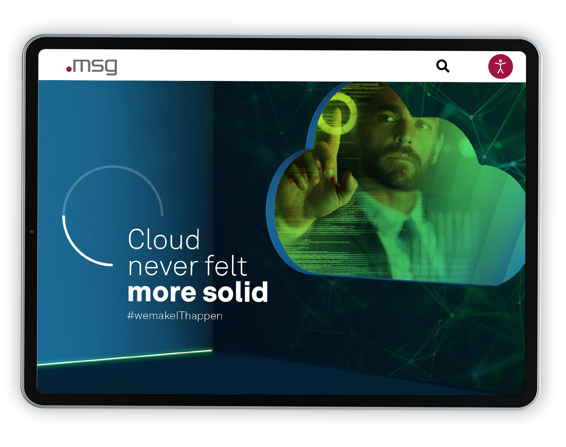



Core competence Cloud
Scaling and speed secure your future
Intelligent solutions and IT consulting
To achieve a successful cloud deployment,
we strike a balance between industry standards
and customized solutions that cater to the unique requirements of your business and industry.
Wherever you may be in your journey – whether you are in the strategy phase, well into the transformation process, or in the midst of implementing managed services – we at msg are here to offer assistance precisely where it is needed.
Our partners:

Slide 22

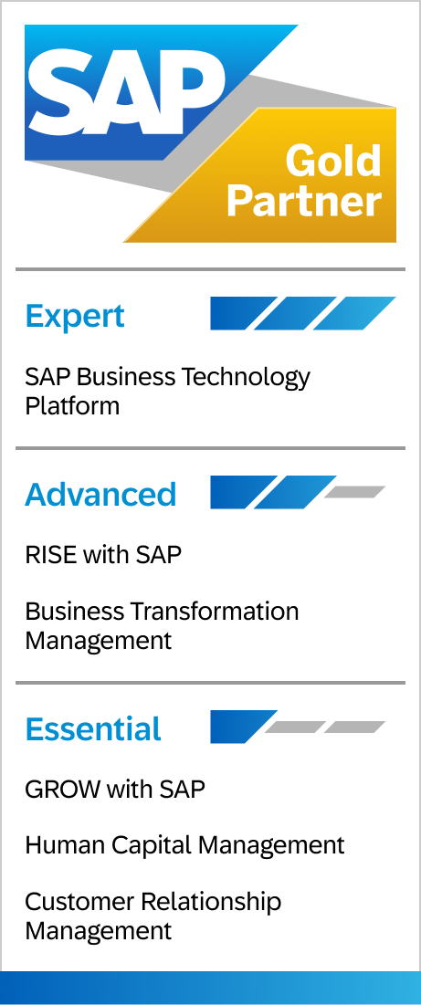


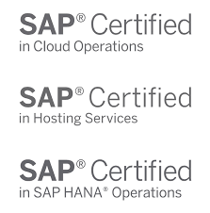


Core competence SAP
As an SAP partner, we have been shaping the digital transformation for over 25 years
Intelligent solutions and IT consulting
Build
Run
Service
Sell
Build
Run
Service
Sell
Development of application software for SAP and customer-specific software solutions
Operation, application management and maintenance of SAP applications
Consulting, implementation
and integration of
SAP products and solutions
Maintenance and sale of SAP software licenses, on-premise and cloud products
Current awards
Solution Extension
Partner of the Year
Digital Core
Intelligent Enterprise
Innovation
Partner Application
Industry Cloud
AI Partner Innovation

Slide 23

3
Trust and competence
Convincing success stories

Slide 24
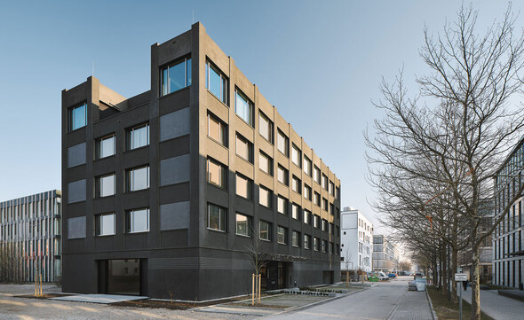

Setup of a central SAP BW/4HANA and SAP Analytics Cloud solution to efficiently pursue strategic corporate goals at REFRATECHNIK
Convincing success stories
Project goals
Efficient pursuit of strategic corporate goals through the establishment of a centralized and KPI-supported analytics system
Implementation of the application based on SAP BW/4HANA
Establishment of direct connection scenarios for further analyses and management reporting in the SAP Analytics Cloud
Establishment of GEO analysts and mobilization of the application
Customer benefits
Development of the central Analytics & Controlling application for flexible analyses and profitability assessments
Strategic consulting for further system development

Slide 25
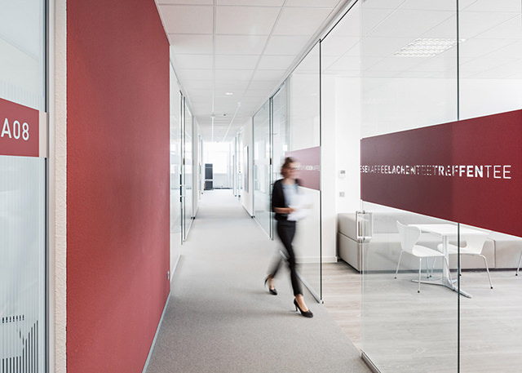

New migration approach for assuming balance sheet control:
Constant financial oversight through SAP FI migration at VIRIDIUM
Convincing success stories
Project goals
Supporting Financial Accounting, Controlling and Group Accounting with FI migration
Creation of migration concept and design of the interface for ongoing data transfer
Creation of mapping for various migration objects
Creation of test concept and operation manual
FI/CO Customizing
Supporting the specialist department with test migrations
Customer benefits
Analysis of financial key figures for better control of business decisions
Increased efficiency through highly automated, data-driven financial processes
Reducing the cost of regulatory compliance

Slide 26



Intelligent heating with Techem: The Cloud way to sustainability
Convincing success stories
Project goals
  Reduction of energy and water consumption
  Increase in healthy housing
  Increasing the transparency of measurement data
Customer benefits
  Capture of measured values from residential units
  Analysis of values in the cloud
  Real-time detection of faults and incorrect settings
  Automated rectification
  Insight into consumption data

Slide 27
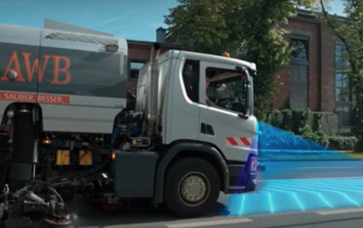


Innovations on Cologne's roads:
Smart Fleet – a pilot project with Abfallwirtschaftsbetriebe Köln
Convincing success stories
Project goals
  Digitalization of reported data for road maintenance
  Automated detection of road damage
  Use of artificial intelligence and machine learning
Customer benefits
  Increase in customer satisfaction
  Increased efficiency by eliminating manual tasks
  Automation

Slide 28

4
Value proposition
Our strengths, your benefits

Slide 29
Sustainable customer relationships are a measure of our success
Our strengths, your benefits
Automotive
Banking
Defense & Aerospace
Public
BMW
VW
Audi
Daimler
Sparkassen-Finanzgruppe
Atruvia
Bayern LB
KfW
Bundesamt für Ausrüstung, Innformationstechnik und Nutzung der Bundeswehr
BWI
Bundesministerium des Innern
Stadtwerke München
ITZ Bund
Bundesverwaltungsamt
Industry
Insurance
Brötje
BSH
CVS
Delivery Hero
Dell
Deutsche Bahn
Deutsche Post
Deutsches
Milchkontor
Emmi
EnBW
Franz Kiel
Google
Magna
Miele
Red Bull
Roche
RWE
Samsung
SAP
Saputo
Telefónica
Toll Collect
Tyson Food
Verizon
Vodafone
Zalando
Achmea
ADAC
Canada Life
AIG
Allianz
AOK Systems
AXA
Concordia
DEVK
ERGO
Gen Re
Generali
Gothaer
HUK-COBURG
MSIG
Munich Re
Pacific Life Re
Provinzial
R+V
Swiss Re
Tokio Marine
UNIQA
Versicherungs-kammer Bayern
VIG
Viridium
Zuger
Kantonalbank
Zurich

Slide 30

Excellent consulting, comprehensive solutions and services for the digital transformation of your business
Our strengths, your benefits
We have the right solution for your specific needs.
01
02
03
04
Efficient and
well thought out
Industry know-how
and IT expertise
from a single source
Exceptional
corporate culture
Awarded for
highest motivation
and best results
End-to-end
solutions
Support from the idea
through implementation
to operation and maintenance
Smart
service portfolio
Intelligent solutions
and applications
for your digitalization

Slide 31





“Stronger together” with our partners
Our strengths, your benefits
Together with our partners, we are pioneers, trailblazers and future makers for digital business models and ecosystems.
Our goal is to assist companies in achieving their ambitious goals. This is why we at msg strive to build and maintain long-term and successful relationships with our business partners.

Slide 32

Fostering an environment of knowledge sharing and nurturing our partnerships reflects our commitment to a sustainable business strategy
Our strengths, your benefits
As an independent and globally operating group of companies with a 40-year history, we see ourselves as trailblazers of a digital future – in a spirit of partnership and sustainability.
Netzwerk Chancen
KI Bundesverband
Charta der Vielfalt
NGEZ
Bitkom
Gaia-X
Gesellschaft für Projektmanagement
Initiative D21
DSAG
IPMA
BiPRO
Allianz für Cyber-Sicherheit
Queb Bundesverband
Catena-X Automotive Network e.V.
International Data Spaces Association
Netzwerk Smart City Berlin
Master Data Alliance
Projekt EMIL
Marco Polo
UN Global Compact
Aleph Alpha

Slide 33

5
Added value for our customers
Digitalization as the
central key to sustainability and ESG

Slide 34




Focus on sustainability and ESG:
We offer our customers E2E support
Digitalization as the central key to sustainability and ESG
Regulatory requirements | We ensure complete coverage of
regulatory ESG requirements.
Sustainability strategy | We ensure a clear positioning vis-à-vis relevant stakeholders.
Sustainability risks | We ensure comprehensive risk management.
Information management | We map relevant information with control tools.
Growth areas | We focus on ESG innovations as an opportunity
for growth.

Slide 35

Focus on sustainability and ESG:
We live our responsibility
Digitalization as the central key to sustainability and ESG
As a signatory to the Charta der Vielfalt (Diversity Charter), we are committed to creating a respectful working environment for all employees.
We have been participating in the UN Global Compact since 2023 and are committed to public progress reporting.
Target for msg in Germany: We aim to reduce our CO2 emissions by 50% by 2025 compared to 2019 and to become climate-neutral by 2030.
Since October 2024: Feeding electricity from the PV system on the roof of our head office in Ismaning into the building grid, including 20 e-charging points.
In 2025, we will be using 100% green electricity at all locations
managed by us.
At msg, we actively promote the careers of women through women's networks as well as trainings and coaching that are tailored to the needs of women.
Notes:
2022 Gründung einer Inklusionsfirma für Barrierefreiheit
im Netz: msg.BiN

Slide 36


Let‘s shape
the digital future
together

Slide 37
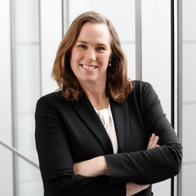


Contact
Marie-Florence von Montgelas
Head of Marketing & Communications
marie-florence.von.montgelas@msg.group
msg systems ag
Robert-​Bürkle-Straße 1
85737 Ismaning/Germany
+49 89 96101-0
+49 89 96101-​1113
info@msg.group

Slide 38
Contact
xxx
Unit xxx
John.Doe@msg.group
+49 152 04803791
msg systems ag
Robert-​Bürkle-Straße 1
85737 Ismaning/Germany
+49 89 96101-0
+49 89 96101-​1113
info@msg.group

